Slide 1
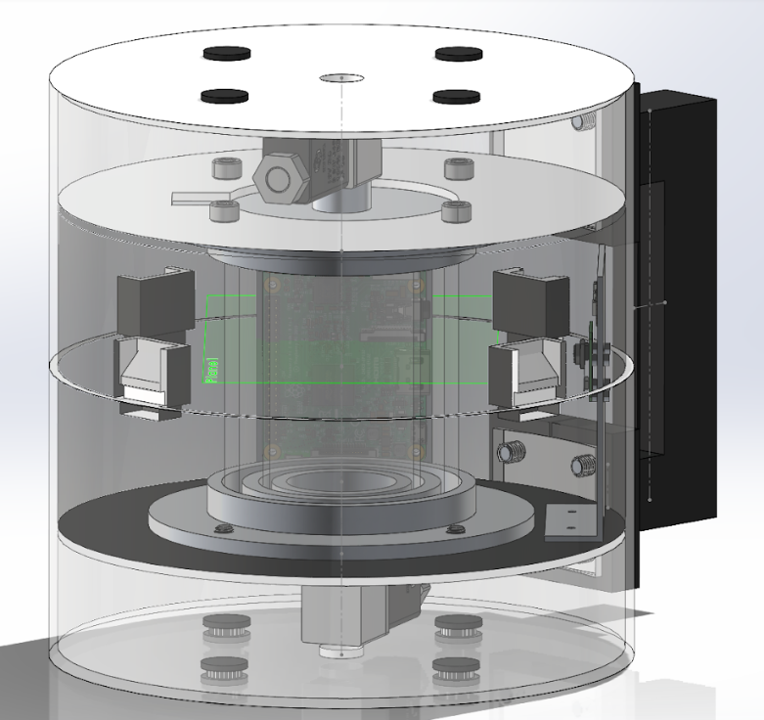
Group 232 Analyzer
Web-application
Remotely controlled via mobile device
Wifi LAN
High Flexibility
Prepare and weigh the test sample using the scale
Weight Check
Weight (g): 170
*Current weight is out of bounds, ensure it is within 190 to 210g
Enter Sampling

Slide 2
Prepare and weigh the test sample using the scale
Rotate Platform
Current Rotation: 30 degrees
Show Camera
*Current tilt is too high, please stabilise
Weight check
Weight (g): 200
If within range, and ‘weight check’ pressed
Start Analysis

Slide 3
Rotate Platform
Current Rotation: 30 degrees
Show Camera
Results
Colour: Indigo
Foam Length: 15mm
If tilt, acceleration and velocity are within range, and ‘Start Analysis’ pressed
Download Report
Start Analysis

